Slide 1
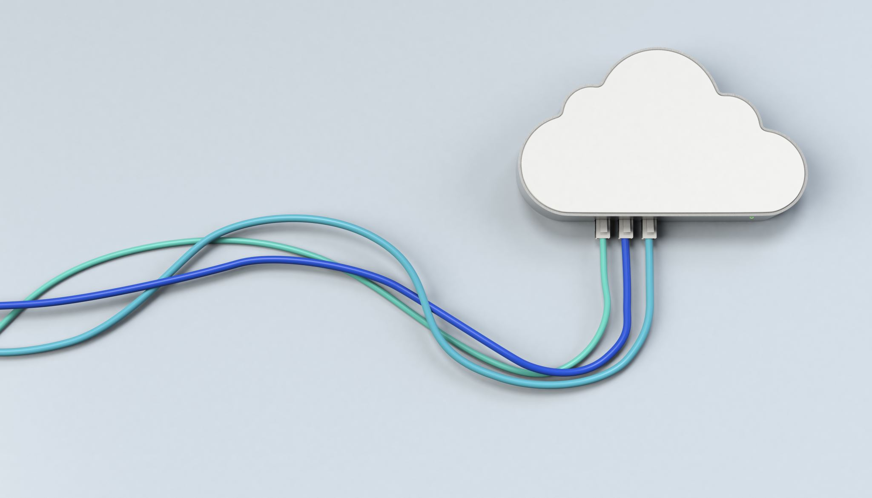
Controlling your busines’s cloud expenses
El-Atmani, Soufiane
Glodici, Mihai
Kosterman, Jorn

Slide 2
Introduction
Why should you monitor your cloud costs?
3 factors for understanding your expenses:
- SKU
- Subsystems
- Customers
Key Pointers to monitor
Best practices
Demo

Slide 3





Why should you monitor your cloud costs?
Lower expenses = Higher Profit
Spend analysis/group => more distributed budget
Monitoring = Control
Service Cost vs Value
Contribution of each team
Cost = Usage
Importance of Resource Upscale Limits
& Downscaling unused resources
Improper monitoring => higher spend
Combining cost data with business KPIs =>
Decisions based on real data, not predictions

Slide 4
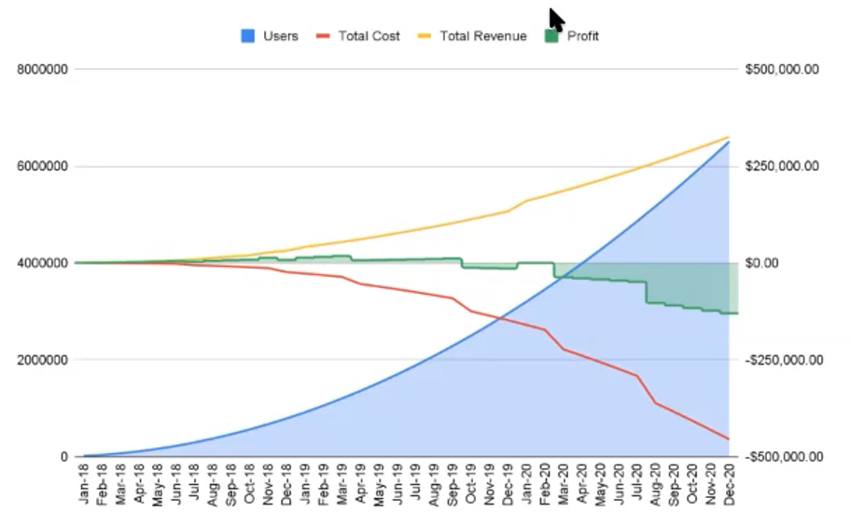
Growth without cost tracking
Exponential growth can lead to non-linear spend resulting in loss of profits

Slide 5
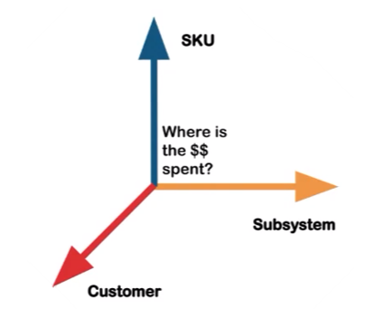
3 factors for understanding your expenses: SKU
We need to ask ourselves: Where does every euro we spend go to?
SKU expenses contain things as: Memory, Cpu’s, storage etc.
This all can be extracted from the cloud provider.

Slide 6
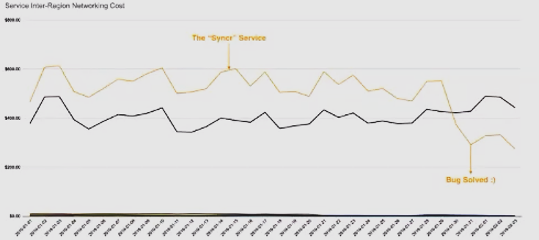
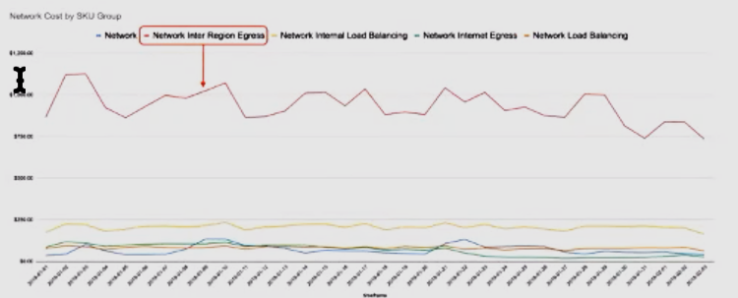
3 factors for understanding your expenses: Subsystems
Analyzing how much is spent per service, product, microservice, etc.
Cost metrics can help discovering bugs within the system.
E.g: Cost not linear ( sync message multiplication in new service)

Slide 7
3 factors for understanding your expenses: Customers
Gather metrics per customer
E.g. Of the so called “Usage data”
BigQuery = Number of rows per customer
Elastic = Number of documents per customer
Microservices = Number of requests per customer
Combine usage data with labeled billing to get the cost per customer.

Slide 8

Other Key Pointers to monitor
Unused resources
Undercommitment
Overcommitment
Price per unit over time
Bugs

Slide 9

Best practices
Gather all billing data from day one
Tagging machines
Configure spending policies and permissions
Build showback culture in org:
- Regulary review billing and alarms
- Communicate breaches with stakeholder
Share billing info with entire orginization

Slide 10

Demo
Tagging
Power BI

Slide 11


The end
Any questions?

